Slide 1


Elementary Science
Science Focus Lesson SC.5.P.8.1
Properties of Matter
Polk County Public Schools
Notes:
TEST ITEM SPECIFICATIONS: (NOTE- This benchmark is assessed every year on FCAT)
Benchmark Clarifications Students will compare and/or contrast the physical properties of solids, liquids, and/or gases.
Students will describe or classify a material as a solid, liquid, or gas.
Content Limit Items will not address or assess particle behavior in each state of matter or between states of matter.
Items will not address or assess the water cycle.
Items may refer to common tools used to measure basic properties of solids, liquids, and gases but will not assess specific knowledge of the tools.
Items will not assess the difference between weight and mass.
Items will not assess unit of measure.
Items will not require unit conversions to compare data.
Items will not address or assess density as a property.

Slide 2
SC.5.P.8.1
Benchmark: Compare and contrast the basic properties of solids, liquids, and gases, such as mass, volume, color, texture, and temperature.
Essential Question:
What are the similarities and differences of the basic properties of solids, liquids, and gases?
Vocabulary:
solid gas
Liquid volume
mass texture
Notes:
Solid – a state of matter in which the substance has a definite shape and definite volume
Liquid – a state of matter in which the substance has a definite volume but takes the shape of its container.
Gas – a state of matter in which the substance takes both the shape and the volume of its container
Volume – the amount of space that an object or substance takes up.
Mass – the amount of matter in an object or substance
Texture - the characteristic appearance of a surface having a tactile quality

Slide 3

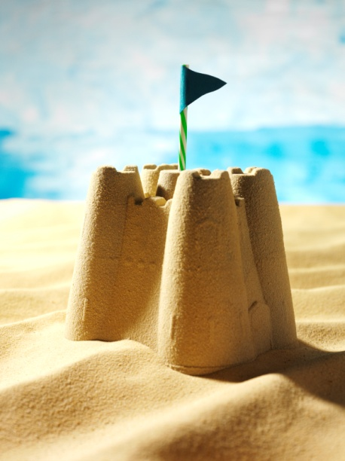
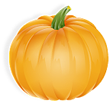
Solid
Solids keep their shape and volume.
Even some very small solids like sand keep their shape when they are moved or put in a container.
Example– If you put a baseball on a table it does not change it’s shape or it’s size.
Notes:
The shape stays exactly the same ( it doesn’t flatten like a pancake)
The size stays exactly the same (it doesn’t get bigger or smaller)
Be sure to dispel the misconception that small solids (like sand and salt) change shape when they are poured…each piece is a separate solid. When small solids are poured from container to container it is like a pile of bricks tumbling and, although the shape of the pile changes, the bricks themselves retain their integrity.

Slide 4
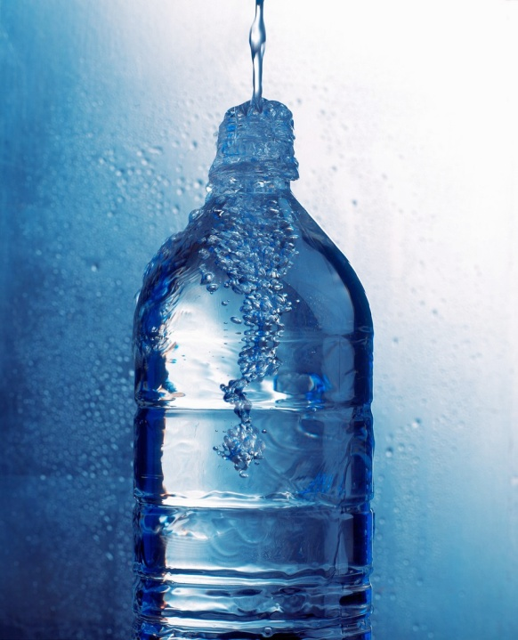
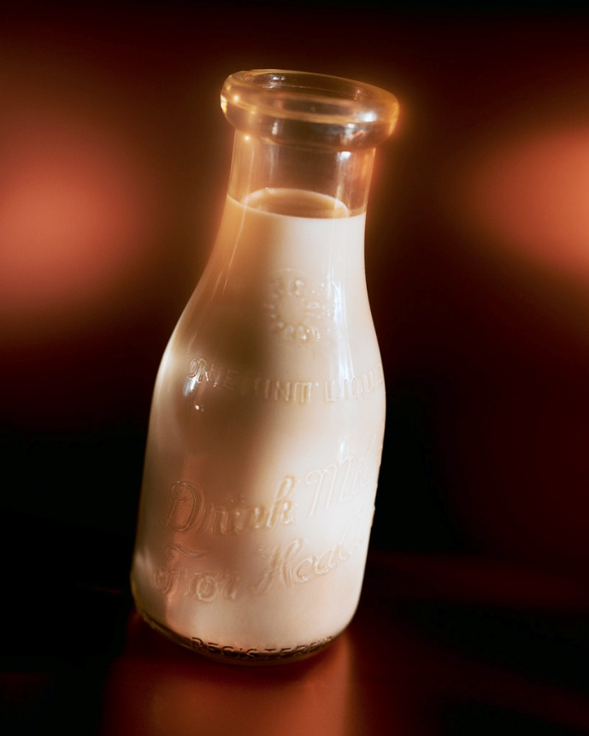
Liquid
Liquid has the ability to flow.
Liquids have a definite volume, but they do not have a definite shape; they take on the shape of their container.
Example – If you have a one liter of milk in a bottle and you pour it in a bowl you still have one liter of milk but it is now a different shape
Notes:
The shape changes based on the container that it is in.
The volume (amount) stays exactly the same.

Slide 5

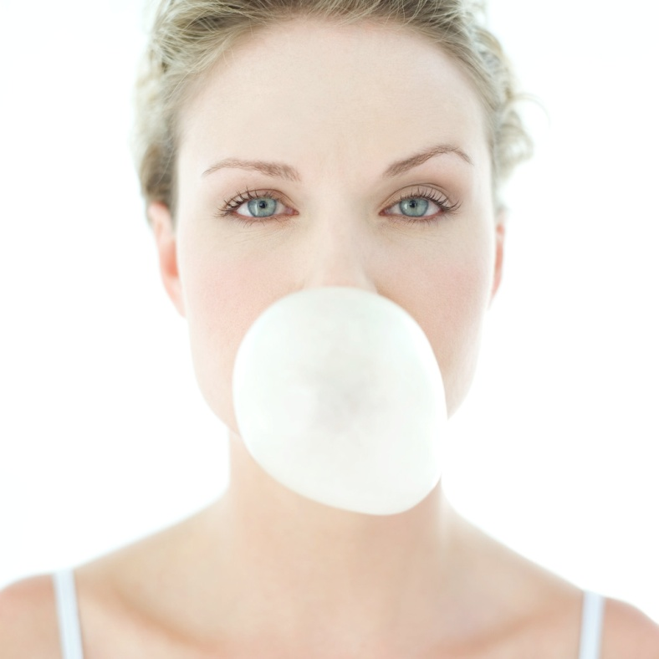
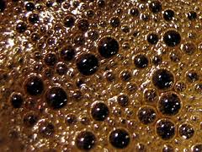

Gas
Gases have not definite volume and no definite shape.
Example – Air in a balloon takes the shape and volume of the bottle. Carbon dioxide gas is compressed and dissolved in soda, when the cap is removed the carbon dioxide escapes and expands to fill the room.
Notes:
The shape changes based on the container that it is in.
The volume changes to fill the container or space.

Slide 6
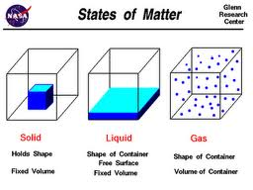
Comparing the States of Matter
Solid – has a definite shape and definite volume
Liquid – has a definite volume but takes the shape of its container
Gas – takes the shape and volume of its container
Notes:
Solids have a definite shape (they are rigid)
Liquids and gasses take the shape of their container (they flow)

Slide 7
Summarizing
Fill in the graphic organizer below by comparing the general properties of Solids, Liquids and Gases.
Solid
No definite shape
Definite shape
Definite volume
Gas
Liquid
No definite volume
Notes:
Solids – definite shape
Solids and liquids – Definite volume
Liquids and Gas – no definite shape
Gas – no definite volume

Slide 8
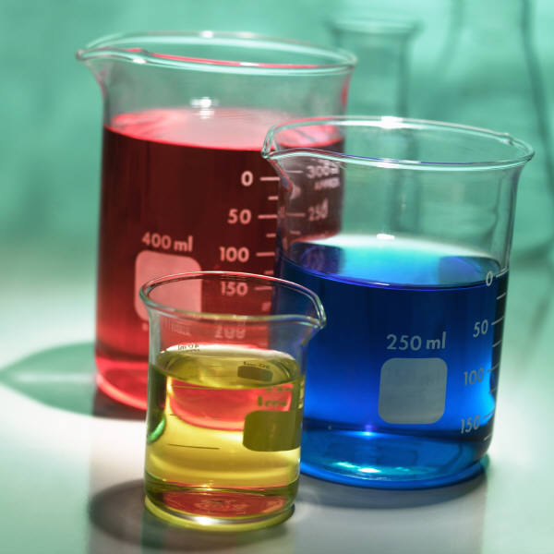
Comparing and Contrasting Matter
Matter (solids, liquids and gases) can be described by its properties
Some properties can be measured.
Some properties are observable without being measured.

Slide 9
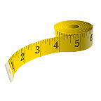
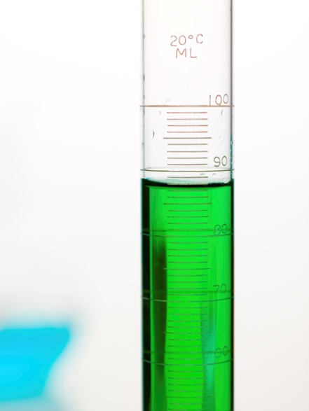
Mass
Volume
Volume is the amount of space that matter (solid, liquid or gas) takes up
Volume can be measured by using a graduated cylinder, a beaker, measuring cups or measuring spoons.
Volume is measured in milliliters (mL) or liters (L)
Volume of regular solids can be calculated by multiplying length x width x height and described in cubic centimeters (cm³)
Mass is the amount of matter in a substance (solid, liquid or gas)
Mass can be measured by using a balance or a spring scale
Mass is measured in grams (g)

Slide 10
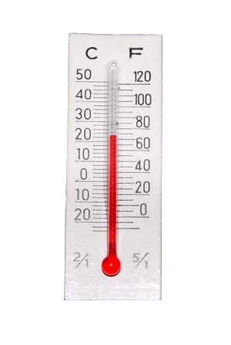
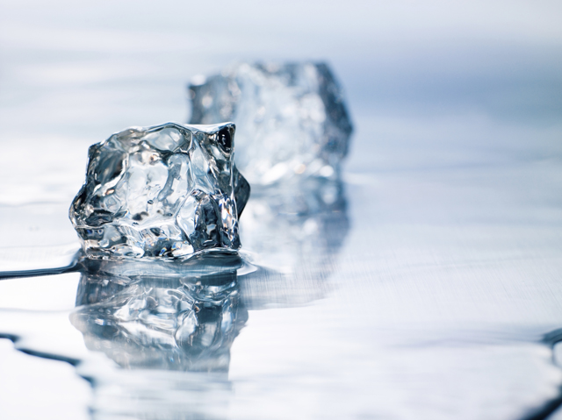
Temperature
Temperature is the average speed of the particles in a substance (solid, liquid or gas)
Temperature is measured by a thermometer.
Temperature is measured in degrees Celsius (ºC)
Temperature can cause a substance to change state. For example: solid to liquid or liquid to gas
Notes:
As temperatures increase, ice(solid) will become water (liquid) or water (liquid) will become water vapor (gas)
As temperatures decrease, water changes from gas to liquid to solid
Remind students that we measure temperature in degrees Celsius in Science

Slide 11
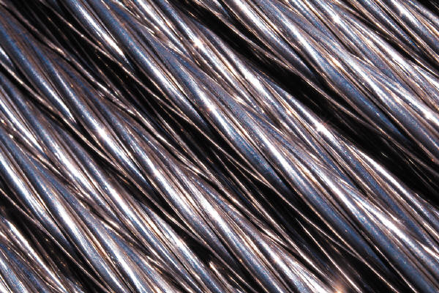
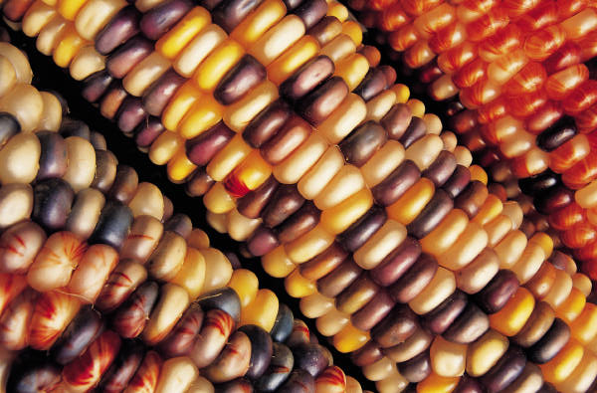
Texture
Texture is the characteristic appearance of a surface having a tactile quality
Observations are used to describe Textures.
Some words that describe textures are, smooth, rough, bumpy, and grainy.
Notes:
Textures are identified by the use of visual and tactile observations.

Slide 12
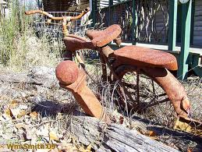
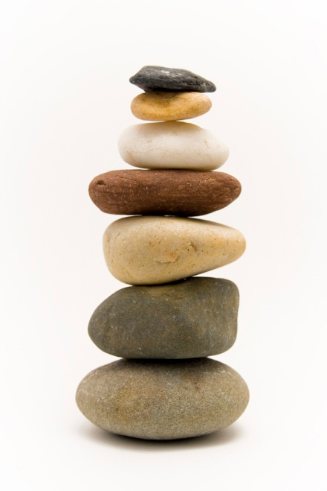
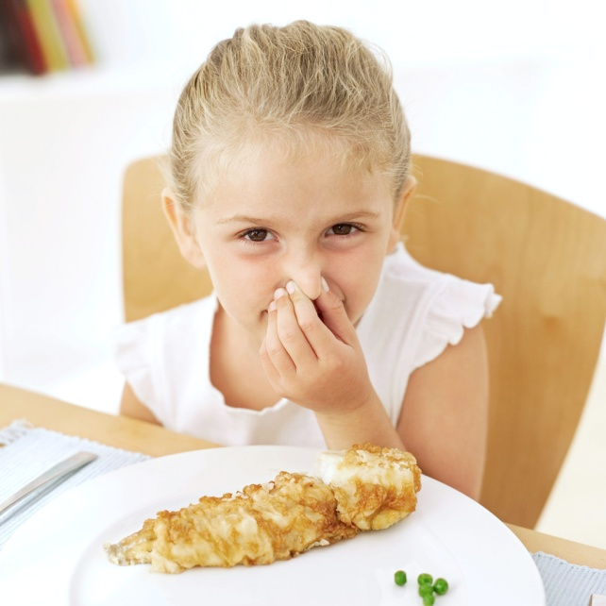
Additional properties of matter
Hardness
Reaction to oxygen (rust)
Color
Shape
Odor
Taste
Attraction to magnets

Slide 13
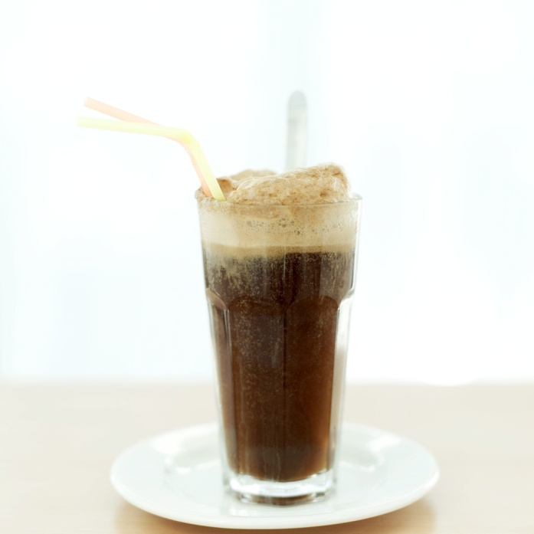

Summarizing
Turn to your shoulder partner.
Partner A use properties to describe the tennis ball.
Partner B use properties to describe a root beer float.

Slide 14
Guided Practice
Talk to your shoulder partner about the answer to each question. Check your work.
What state of matter has a definite volume but takes the shape of the container it is in.
Solid
Liquid
Gas
All are the same
Notes:
Have the students hold up a card with their response on it (A,B,C,D) so that you can easily see if the students are getting the correct answer.

Slide 15
B
The answer is
Liquids have a definite volume but the shape changes with the container that it is in.

Slide 16
Guided Practice
What type of material is most likely to rust?
metal
glass
wood
Cloth
Notes:
Have the students hold up a card with their response on it (A,B,C,D) so that you can easily see if the students are getting the correct answer.

Slide 17
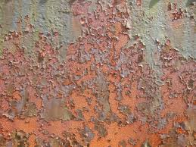
A
The answer is
Some metals can rust. Glass, wood and cloth do not rust.

Slide 18

Guided Practice
Samantha is doing a lab in her fifth grade science class. She needs to compare the masses of two blocks of wood. Which tool should she use?
.
.
.
.
Notes:
Have the students hold up a card with their response on it (A,B,C,D) so that you can easily see if the students are getting the correct answer.

Slide 19
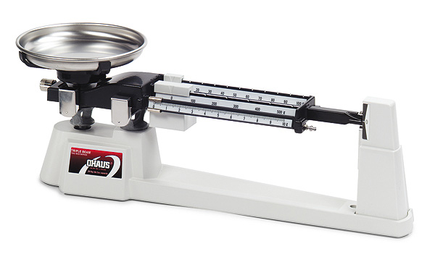
D
The answer is
We measure mass by using a balance. The graduated cylinder, beaker and the ruler are used to measure volume not mass.

Slide 20
Summarizing
Pass a piece of paper around the table. Each group member adds a detail that answers the question. Keep the paper moving until time is called- see how many ideas your group can generate!
Essential Question:
What properties can be used to describe a substance?

Slide 21
Check Your Understanding
Number your paper from 1-4, select the answers that you think are correct
Which of the following instruments would be needed to determine the volume of liquid in a small jar?
  A meter stick
  graduated cylinder
  A larger jar
  A metric weight

Slide 22
Check Your Understanding
2. Kyle and Jan are comparing two samples of matter. They make a table of the properties of each sample. PROPERTIES OF SAMPLES
Which property provides the best evidence that both samples are solids rather than liquids?
  a. color c. shape
  b. mass d. volume
Property | Sample 1 | Sample 2
Color | Red | Silver
Mass (grams) | 30 | 5
Shape | Pyramid | Cube
Volume (milliliters) | 40 | 3

Slide 23

Check Your Understanding
3. Mrs. Wilson needs 35 mL of vinegar to do a science demonstration for her class. Which tool should she use to measure the correct amount of vinegar?
.
.
.
.

Slide 24
Check Your Understanding
4. Which property of matter can be used to easily separate aluminum cans from steel cans at a recycling center?
  magnetic attraction
  reaction to oxygen
  heat conduction
  electrical conductivity

Slide 25
Check Your Answers
B
C
A
A
Notes:
B - volume of a liquid can be easily measured in a graduated cylinder
C – Shape is the best answer because solids are the only ones that have a definite shape
A – Liquid can be measured in milliliters with a graduated cylinder not a ruler, thermometer or a scale
A – Steel is magnetic but aluminum is not magnetic so they could easily be separated with a magnet

Slide 26
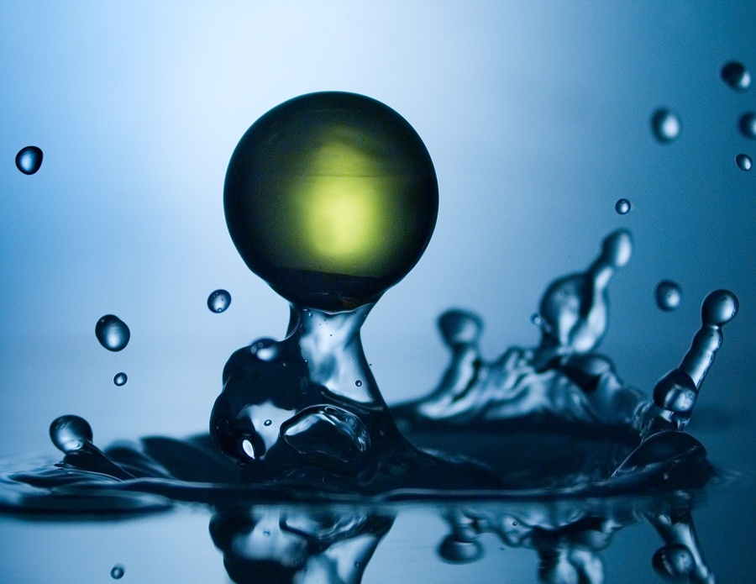
Summary Question
In your science journal explain the similarities and differences of the basic properties of solids, liquids, and gases?
Notes:
Be sure to set high expectations for a written summary!

