Slide 1


Elementary Science
Science Focus Lesson
SC.5.N.1.1
Practice of Science
Polk County Public Schools
Notes:
TEST ITEM SPECIFICATIONS
Benchmark Clarifications
Students will evaluate a written procedure or experimental setup.
Students will identify appropriate forms of record keeping.
Students will interpret and analyze data to generate appropriate explanations based on that data.
Students will identify examples of or distinguish among observations, predictions, and/or inferences.
Students will explain the difference between an experiment and other types of scientific investigations.
Students will identify a control group and/or explain its importance in an experiment.
Content Limits
Items will not require the identification or evaluation of a hypothesis. Items should not use the term hypothesis.
Items will not require the design of a procedure.
Items will not require mathematical computations.
Items will not require the differentiation between outcome variables (dependent variables) and test variables (independent variables).
Items will not assess the reason for differences in data across groups that are investigating the same problem.
Items referring to conclusions will not require the formation of a conclusion.

Slide 2
SC.5.N.1.1
Benchmark: Define a problem, use appropriate reference materials to support scientific understanding, plan and carry out scientific investigations of various types such as: systematic observations, experiments requiring the identification of variables, collecting and organizing data, interpreting data in charts, tables, and graphics, analyze information, make predictions, and defend conclusions.
Essential Question: How do scientists answer questions about the natural world?
Vocabulary:
experiment observation inference
predict data experiment control group investigation
Notes:
Experiment––A scientific test or procedure that is carried out under controlled conditions to answer a scientific question.
Observation––Information about the natural world gathered through the senses and/or scientific instruments.
Inference––An explanation based on evidence that is not directly observed.
Predict— To state what one thinks will happen under certain conditions based on data or observation.
Data— Measurements or observations collected and recorded in an experiment or investigation.
Experiment–– A scientific test or procedure that is carried out under controlled conditions to answer a scientific question
Control group— A group in a scientific experiment that serves as a reference for comparison
to the experimental group; a group that is untreated by the factor being tested.
Investigation––An organized scientific study of the natural world that may include making
systematic observations, asking questions, gathering information, analyzing data, summarizing
results, drawing conclusions, and/or communicating results.

Slide 3
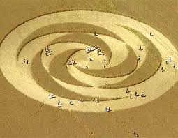
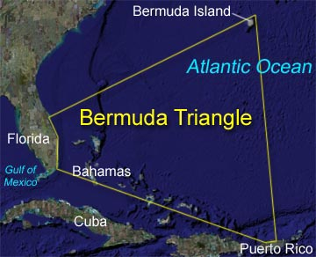
What do scientists do?
Nature is full of questions and mysteries.
Scientists look for answers to questions about the natural world.
Scientists collect clues to nature’s mysteries.
Scientists try to figure out what the clues mean.
What forms crop circles?
Why do ships and planes go missing in the Bermuda Triangle?

Slide 4
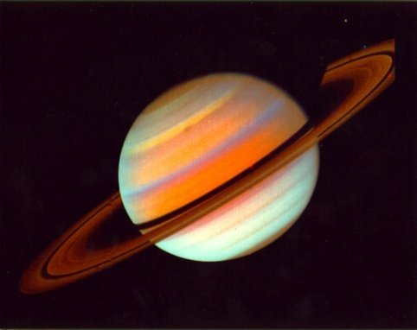
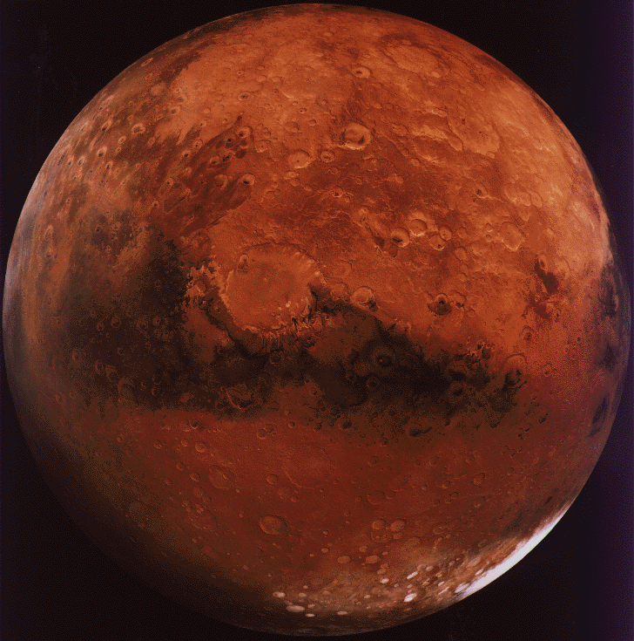
What is a scientific question?
Many questions that scientists ask begin with What, How, When, Where or Why
Scientific questions can be answered by gathering observations or measurements, called data
Some questions are not scientific because they mean different things to different people, no data can be gathered to answer these questions
How many rings does Saturn have?
Is Saturn prettier than Mars?
Notes:
Emphasize the difference between scientific questions (data can be gathered) and non-scientific questions (no data can be gathered).
Scientific: How deep is the puddle? (deep can be measured)
Non-Scientific: Is the puddle big or small? (big or small mean different things to different people)

Slide 5
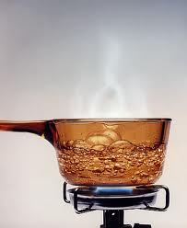
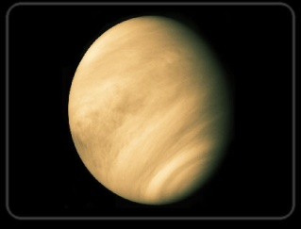
How does a scientist find clues?
Different kinds of scientific questions require different kinds of investigations
To find out the temperature at which water boils, a scientist would boil water and take the temperature with a thermometer-this can be done very quickly
To find out if the planet Venus has phases like the moon, a scientist would use a telescope to observe Venus for many months.
What is the boiling temperature of water?
Does Venus have phases?
Notes:
Investigation––An organized scientific study of the natural world that may include making
systematic observations, asking questions, gathering information, analyzing data, summarizing
results, drawing conclusions, and/or communicating results.

Slide 6
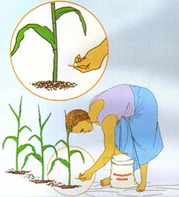
How does a scientist find clues?
Sometimes a scientist predicts the answer to the scientific question, this is called a hypothesis
A scientist must design a controlled experiment to test the prediction
Scientists must change one variable to see if it affects the experiment the way that was predicted
They must compare the results to a control group, a group that did not have the variable changed
The scientist gets clues to the answer by comparing the two groups
Does fertilizer make corn plants yield more corn?
Notes:
Predict— To state what one thinks will happen under certain conditions based on data or observation.
Control group— A group in a scientific experiment that serves as a reference for comparison
to the experimental group; a group that is untreated by the factor being tested.
Experiment–– A scientific test or procedure that is carried out under controlled conditions to answer a scientific question

Slide 7
Summarizing
Question: what are some things that scientists do to find answers to questions about the natural world?
Rally Table:
One person in a cooperative group write a word or phrase to answer the question
Pass the paper and pencil to the left and the next member write another response to answer the question
Continue passing the paper/pencil around the table, each student adding to the team list
Continue until the teacher calls time
Take turns sharing responses with the class
Notes:
Possible responses:
Ask questions
Observe
Predict, make a hypothesis
Investigate
Experiment
Design a controlled experiment
Look for clues
Measure
Collect data
Figure out what clues mean
Change variables

Slide 8

How do scientists keep records?
Scientists keep careful records of their investigations in a journal
Scientists record their prediction
Scientists carefully describe their procedures
Scientists record their observations and the data that they collect
Scientists jot down notes about observations they are curious about, what they might like to do in the future, and other thoughts that they have while doing their investigation
Science Journal
Date: 9-1-2011
Hypothesis: Heartbeat will increase when aerobic activity is done
Procedure:
Select a group of 5 boys, all 11 years old
Have the boys stand still for 5 minutes
Take their pulse by

Slide 9
How do scientists collect and organize data?
How does aerobic activity affect heartbeat?
Data provides clues to help scientists figure out the answer to their question
Scientists keep careful records of their data in their journal
Data is recorded on a spread sheet right away
Data is recorded even if the scientist thinks that it may be wrong
Data must include both numbers and units of measure
Trial | Standing Still | Running in Place
1 | 75 BPM | 89 BPM
2 | 77 BPM | 92 BPM
3 | 74 BPM | 88 BPM
4 | 80 BPM | 87 BPM
5 | 78 BPM | 95 BPM
The CONTROL GROUP , the group standing still, is used for comparison when the test variable, running in place, is changed.
Notes:
BPM is Beats Per Minute
Students standing still would be the control group.
The changed variable (test variable or manipulated variable) is running in place
Remind students that all variables, except the level of activity, must remain constant. Examples might include:
Age of students who are being tested
Gender of students who are being tested
Time that students run in place
Method of counting heartbeat
How soon after eating the test was done
What the students ate

Slide 10
How does data provide clues to answer the scientific question?
Scientists must try to understand what the data means
They make graphs of their data to help them understand the clues
Scientists analyze the data to help them explain the answer to their question
Only average data needs to be graphed so that the patterns can be compared.
Notes:
Bar graphs of average data are used to compare patterns.
When an investigation involves change over time, a line graph would be appropriate.

Slide 11

How does data answer the question?
I predicted that aerobic activity would increase heartbeat. My data supported my prediction! Therefore, the answer to my question is that aerobic activity increases heartbeat!
Scientists look for patterns in the data
Only accurate data is good data
Measuring must be done carefully and correctly
Trials must be repeated many times in order to find patterns
Data must be compared to the original prediction
Clear patterns in the data help to answer the scientific question
Notes:
Refer back to the graph on slide 10-the pattern clearly shows an increase in BPM when the aerobic activity was increased to running in place

Slide 12
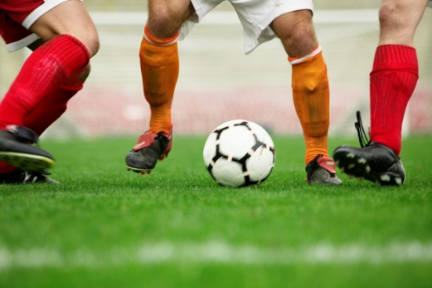
Does any data answer the question?
I
Scientists must make sure that their data matches the question that was asked
If the question asks what kind of seed a canary prefers, the experiment must test different seeds, not different times of feeding the canary
If a question asks what kind of grass is fastest for soccer, the experiment must test different types of grass, not different balls
What type of seeds do canaries prefer?
What type of grass allows a soccer ball to move faster?
Notes:
Help students understand that the data must be appropriate to answer the original question.

Slide 13
How does a scientist use the data to answer the question?
A conclusion is an explanation about what the data from an investigation showed. It answers the question
The conclusion must be based on observations and gathered data
An inference would be a “possible explanation” based on past experience but NOT on observations. An inference is NOT a conclusion to a scientific question.
Conclusion: Running causes heartbeat to rise. The data showed this to be true.
Inference: I think that running causes the heartbeat to slow down because I always feel tired after PE.
Notes:
Emphasize the difference between a conclusion (based of patterns in the data) and an inference (based on thoughts about past experiences).

Slide 14
Summarizing
THE MOST IMPORTANT THING!
Each person in a cooperative group tell the rest of the group THE MOST IMPORTANT THING that a scientist does when looking for answers about the natural world.
Notes:
All answers are correct…every part of the practice of science is important!
Randomly call on 3-4 students and have them share their responses out loud for the class to hear.

Slide 15
Guided Instruction: Talk to your shoulder partner about the answer to each question. Check your work.

Slide 16
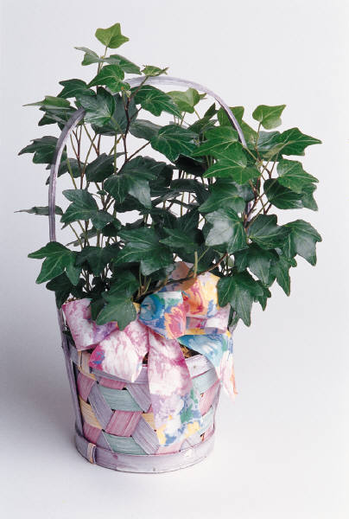
D
The answer is
Maria observed that she had treated the plants differently by watering them differently
She predicted that less water was better
She needs to test her hypothesis by watering the withering plants less

Slide 18
B
The answer is
A scientific investigation can be done to find out which fertilizer is most effective
Fun games and book preferences are different for different people; no data can be gathered to answer question A or C
Volcanoes can be observed but cannot be tested in a controlled experiment!

Slide 20
B
The answer is
Science is always based on what actually happened
Scientists never change predictions or change data
Scientists analyze the data that was collected to try to understand what that data means!

Slide 22

C
The answer is
Scientists keep detailed journals about their investigations
Scientists record their prediction their procedures, their observations, their data, and their thoughts

Slide 23
Summarizing
Pair Share
  Find a partner
  Taller partner talk for 30 seconds to shorter partner , talk about things that a scientist does to find answers to questions about the natural world
  Shorter partner talk for 30 seconds to taller partner, talk about more things that a scientist does to find answers to questions about the natural world
Notes:
Time this activity.
Model for the students. Make sure that the listening partner understands how to actively listen without talking. Make sure that the talking partner knows to talk for the entire 30 seconds.

Slide 24
Check Your Understanding
1.

Slide 25
Check Your Understanding
2.
Notes:
Emphasize that a line graph is appropriate for showing change over time

Slide 26
Check Your Understanding
3.

Slide 27
Check Your Understanding
4.

Slide 28
Check your Answers
C- this investigation used a model which could only provide limited information about a heart
A- a bar graph is the right graph for comparing different sets of data
A- Grandfather was able to re-read his journals so that he could replicate what he had done in the years that he produced good vineyards
C- The temperature increases as the line goes higher
Notes:
Emphasize that, although models help us understand about natural events, they all have limitations.

Slide 29
Summarizing
Write a summary paragraph to explain how scientists find answers to questions about the natural world. Include a topic sentence, at least 4 detail sentences, and a concluding sentence.
Notes:
Be sure to hold the students to high expectations for writing a summary paragraph.

