Slide 1


Elementary Science
Science Focus Lesson SC.4.E.6.4
Weathering and Erosion
Polk County Public Schools
Notes:
TEST ITEM SPECIFICATIONS:
Benchmark Clarifications
Students will identify and/or describe the processes of physical weathering and/or erosion.
Students will compare and contrast the agents and/or the processes of physical weathering and erosion.
Content Limit
Items may address but will not assess specific landforms resulting from physical weathering and erosion.

Slide 2
SC.4.E.6.4
Benchmark: Describe the basic differences between physical weathering and erosion
Essential Question:
How does weathering and erosion affect the Earth's surface?
Vocabulary:
weathering
erosion
sediments
Notes:
Weathering-breaking down of rocks
Erosion-moving of sediments
Sediments-bits of rocks, sand, soil, shells, weathered materials

Slide 3
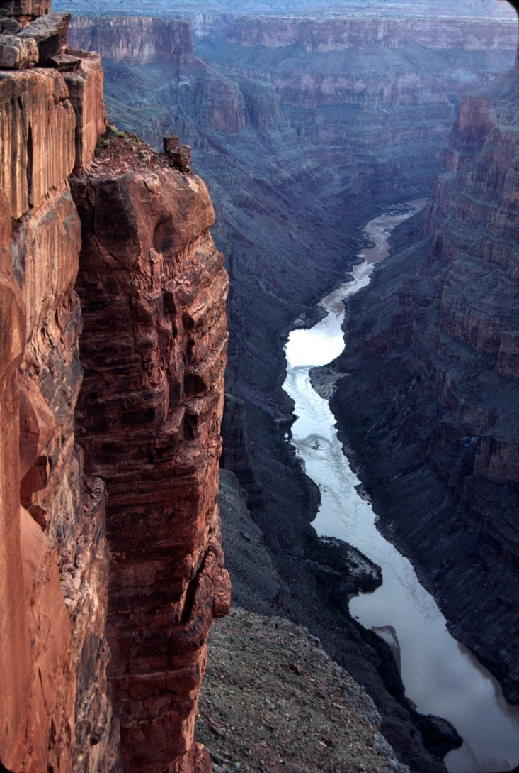
Weathering and Erosion
Many of the changes to Earth’s surface happen so slowly that they are barely noticeable.
Water and bits of rock rushing down stream causing pieces of the surrounding land to break off and move down stream.
It took the Colorado River six million years to carve out the Grand Canyon pictured on the right.
Notes:
Students should understand that even though they may not see the Earth’s surface changing it may be happening very slowly.

Slide 4


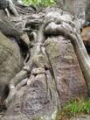

Weathering
Earth’s surface is exposed to water, wind, ice and growing plants. Each of these can break down rocks into smaller pieces. This breaking down of rock is called weathering.
Notes:
Weathering is defined as the breaking down of rock by wind, water, ice, temperature change, and plants.

Slide 5
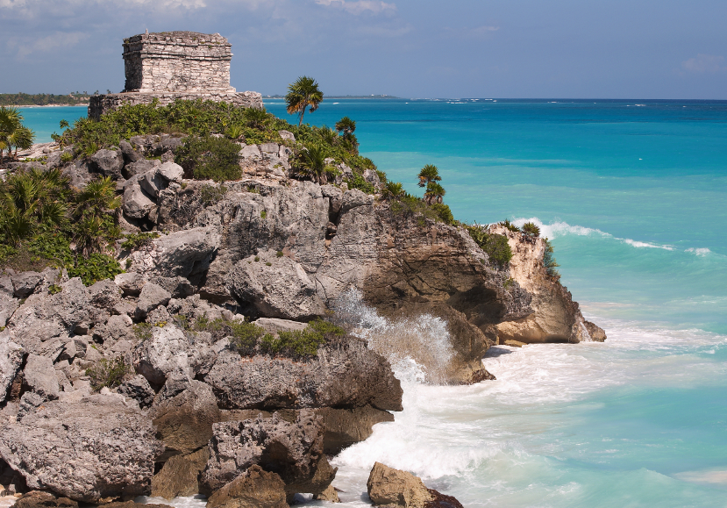
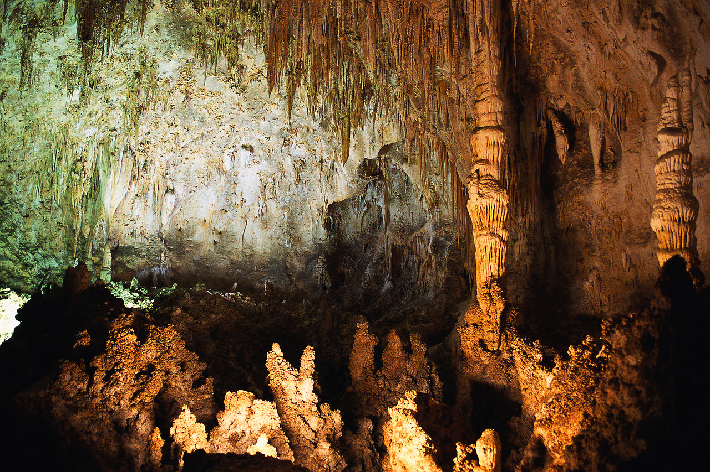
How does water cause weathering?
Moving water can carry bits of sand and rock that chip away at other rocks.
Water can dissolve the minerals that make up rocks. Minerals in rocks dissolve at different rates. This can cause caverns to form.
Notes:
Weathering caused by water can take place along beaches, rivers, underground caves, rivers, streams, etc.

Slide 6
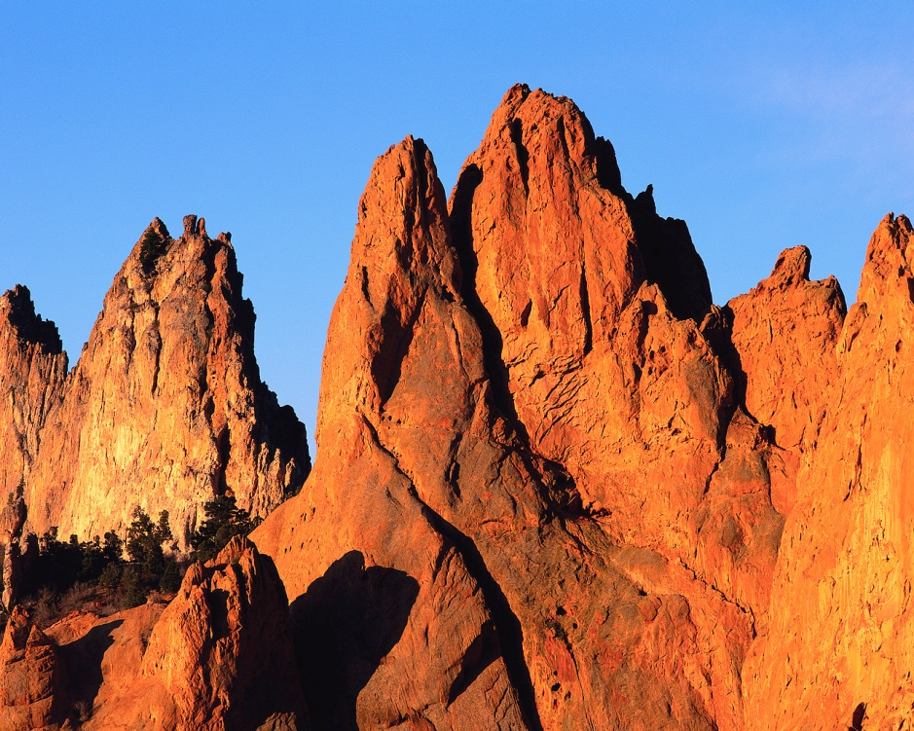
How does wind cause weathering?
Wind contains sand that scrapes against rocks and wears it away.
Notes:
Wind with its tiny bits of sand can be compared to sandpaper.

Slide 7
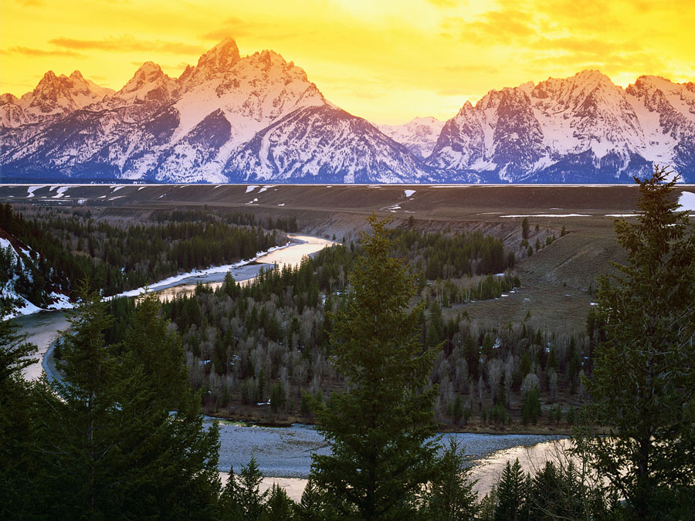
How does ice cause weathering?
When water gets into the cracks of rocks it can freeze and expand. The expanding water can break a rock into pieces.
Notes:
Make sure students understand the power of water and its ability to expand. Freeze a “FULL” water bottle to show the expansion. Then compare that expanded water bottle to rock.

Slide 8
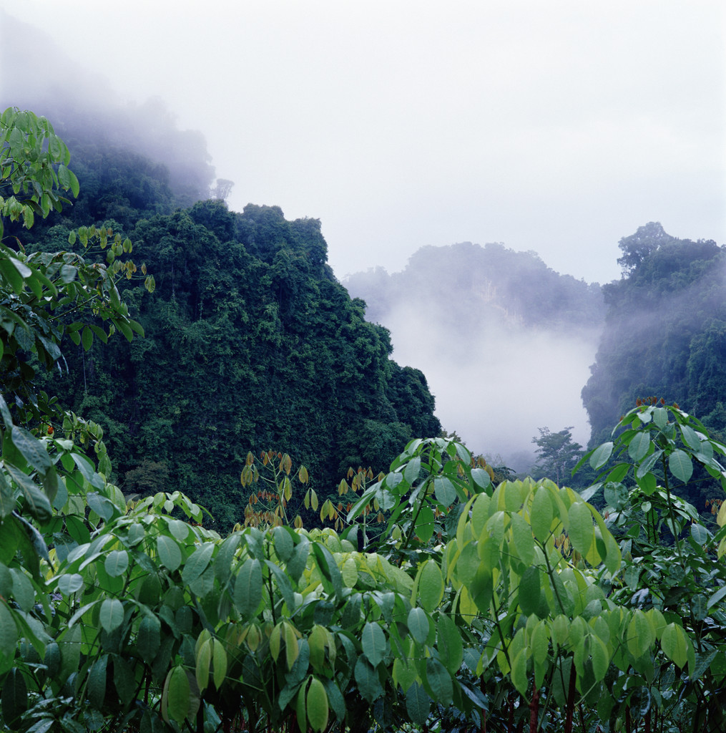
How do plants cause weathering?
Roots can get into the cracks of rocks. These roots spread out inside the cracks causing the rock to break apart.
Notes:
Plant roots are often thought to be less powerful than rock. Students may stay stuck in their belief that roots could not break apart rock.

Slide 9
Summarizing
Define Weathering
Name one weathering agent
Name one weathering agent
Name one weathering agent
Name one weathering agent
Draw this graphic organizer in your science notebook. Fill in each bubble.
Notes:
Weathering: breaking down of rock
Weathering Agents: Water, Wind, Ice, Plants

Slide 10
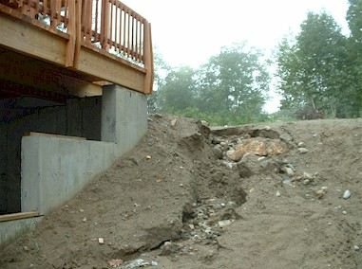
Erosion
Erosion is the movement of weathered materials by water, wind, or ice.
Erosion moves sediments to new locations.
Notes:
Have student pay close attention to the word in red “movement” as this is the key difference between weathering and erosion.

Slide 11
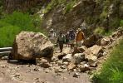
What causes erosion?
Erosion is the movement of weathered material to a new location.
Moving water, wind or ice can cause broken down rock to be carried to a new location.
Gravity can also cause erosion in the form of landslides.
Notes:
When wind, water and ice are moving quickly enough they will carry away bits of rock. When they slow down that rock gets dropped or deposited in a new location (deposition).

Slide 12
Summarizing
Turn to your shoulder partner.
Partner A define weathering.
Partner B define erosion.
Partner A explain why weathering must occur before erosion can take place.
Partner B paraphrase why weathering occurs before erosion can take place.
Notes:
Erosion can only occur when there are weathered particles that can be moved.

Slide 13
Guided Practice
Talk to your shoulder partner about the answer to each question. Check your work.
Dry, loose materials are easily eroded by the wind. Where would the most wind erosion occur?
along a sandy beach
in a forest
along a rocky beach
in a rocky canyon
Notes:
Have the students hold up a card with their response on it (A,B,C,D) so that you can easily see if the students are getting the correct answer.

Slide 14
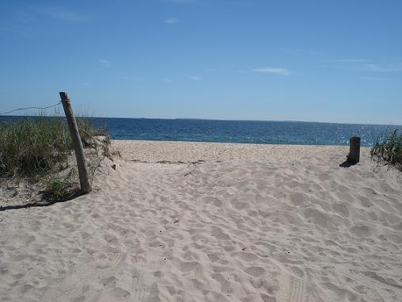
A
The answer is
A sandy beach has small weathered particles (sand) which are easily moved by wind. There is also nothing blocking the wind on a beach so it blows very steadily!
Notes:
In order for erosion to occur there must be weathered particles. Sand is very finely weathered and is therefore very easily moved by wind.

Slide 15
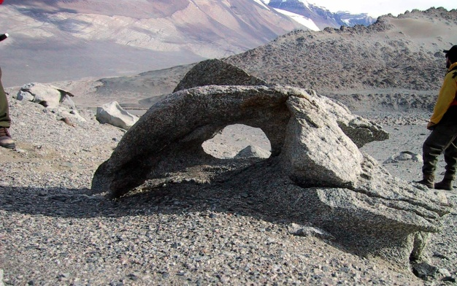
Guided Practice
What is the best explanation of the unusual rock formation shown in the photograph?
Water erosion carried rock particles to a new location
Rocks are made of a mixture of minerals which weather at different rates
Plant roots caused the rock to break apart
The rock formed this way
Notes:
Have the students hold up a card with their response on it (A,B,C,D) so that you can easily see if the students are getting the correct answer.

Slide 16
B
The answer is
Erosion does not wear away rock. Weathering happens at different rates depending on the hardness of the mineral. Rocks are a mixture of minerals so one part of a rock might weather faster than another part.

Slide 17
Summarizing
Pass a piece of paper around the table. Each group member adds a detail that answers the question. Keep the paper moving until time is called- see how many ideas your group can generate!
Essential Question:
How does weathering and
erosion affect the Earth's surface?

Slide 18
Check Your Understanding
Number your paper from 1-3, select the answers that you think are correct
Which of the following is an example of erosion?
  A crack in a rock
  Plant roots growing through a rock
  A landslide
  Water dissolving rock

Slide 19
Check Your Understanding
2. What is the best explanation of what might cause a beach to erode?
  Plant roots
  Rain
  Waves
  Ice

Slide 20
Check Your Understanding
3. Which change in the Earth’s surface is an example of weathering?
  A mountain range becomes worn down over time
  A rock slide occurs on a steep mountain
  Small pebbles are carried along by a river current
  A sand dune grows larger from blowing sand

Slide 21
Check Your Answers
C
C
A
Notes:
Erosion involves the moving of particles, like a landslide
Waves are the most likely cause of beach erosion due to their proximity!
Weathering is wearing down, the other choices are examples of erosion

Slide 22
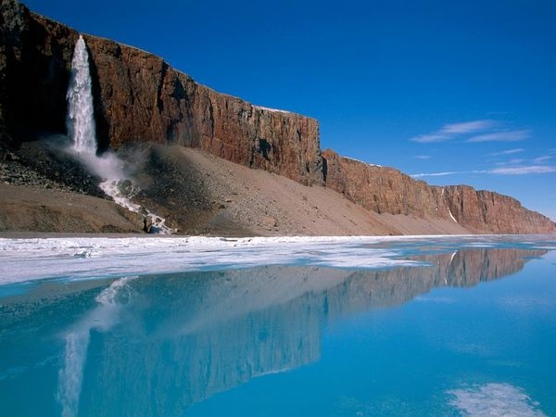
Summary Question
In your science journal compare and contrast weathering and erosion.
Notes:
Be sure to set high expectations for a written summary!

