Slide 1


Elementary Science
Science Focus Lesson
SC.4.E.6.2
Rocks and Minerals
Polk County Public Schools
Notes:
TEST ITEM SPECIFICATIONS:
Benchmark Clarifications:
Students will identify and/or describe the physical properties of common minerals.
Students will describe and/or explain the role of minerals in the formation of rocks.
Students will identify the three categories of rocks and how they were formed.
Content Limits
Items will not assess the identification of a specific mineral based on its properties.
Items addressing common minerals are limited to quartz, feldspar, mica, calcite, talc, pyrite, and graphite.
Items will not require the identification of specific mineral composition of any type of rock.
Items will not require knowledge of Moh’s hardness scale.
Items will not assess the rock cycle.

Slide 2
SC.4.E.6.2
Benchmark: Identify the physical properties of common earth-forming minerals, including hardness, color, luster, cleavage, and streak color, and recognize the role of minerals in the formation of rocks.
Essential Question:
What are some of the common physical properties of minerals? What is the role of minerals in the formation of rocks?
Vocabulary:
hardness color luster cleavage
streak mineral rock

Slide 3
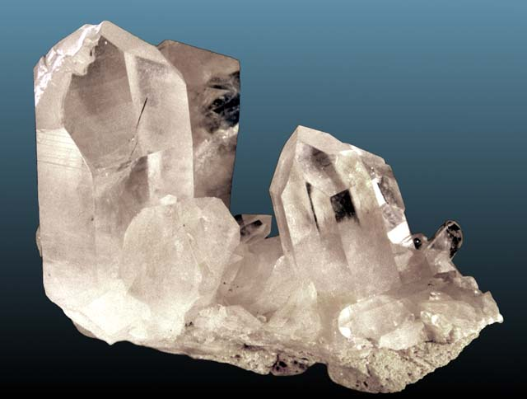
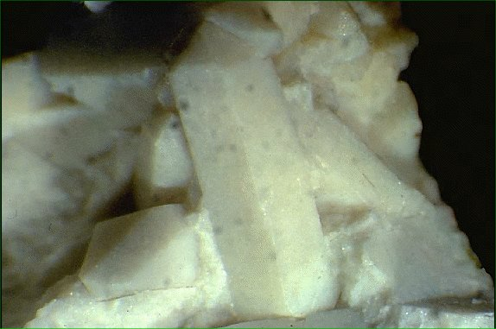
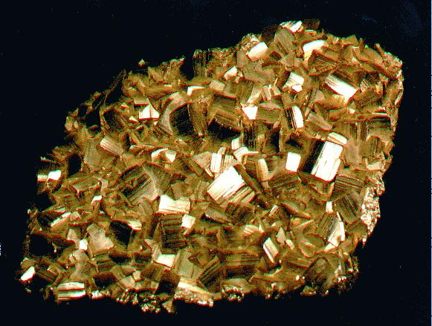
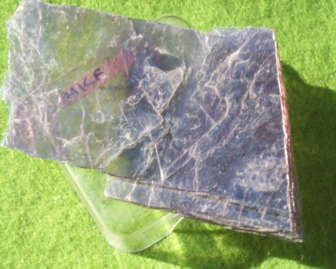
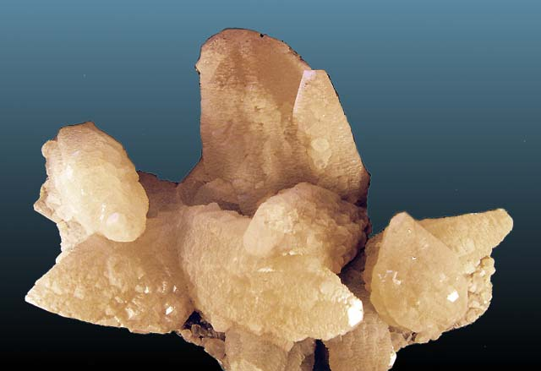
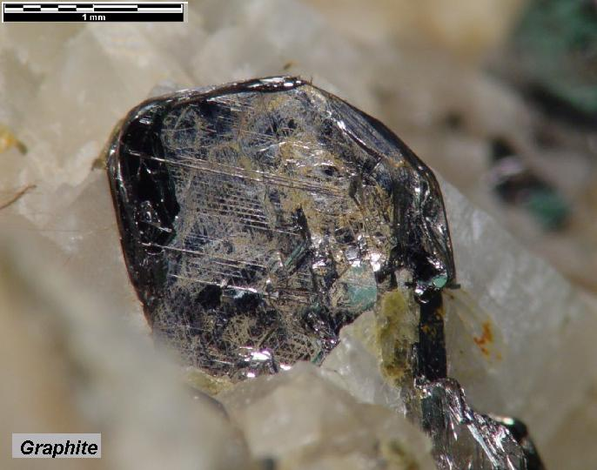
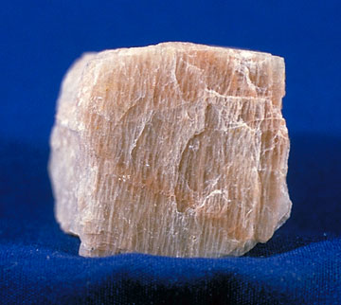
What is a mineral?
quartz
A mineral is…
A solid material formed by nature in or on Earth’s crust
A material that has a crystal form
A material that has its own set of properties
A material that is not formed by a living thing
pyrite
talc
calcite
pyrite
mica
graphite
feldspar
Notes:
These particular minerals are mentioned in the test item specifications and may be mentioned in test questions. Help familiarize the students with the names of these minerals. They will not be expected to identify them, just recognize their names.

Slide 4
How can we identify minerals?
Minerals are identified by their properties. Each mineral has its own set of properties. No two minerals have the same set of properties.
Color: A mineral may be one color or different colors
Luster: Luster is how a mineral’s surface reflects light. A mineral can be shiny, glassy, dull, or metallic.
Hardness: A mineral may be very hard, very soft, or somewhere in the middle. A diamond is the hardest mineral, talc is the softest.
Streak: Streak is the color of the mark that a mineral makes when it is scraped on a white tile.
Cleavage: Cleavage describes how a mineral breaks. Cleavage means breaking along a smooth, flat surface,
Notes:
Explain that hardness is determined by scratching minerals with common materials of known hardness such as a fingernail, copper penny, steel nail, glass. None of these will scratch a diamond (hardness of 10), all of these things will scratch talc (hardness of 1).
Some minerals do not exhibit cleavage; they fracture or break along a rough or jagged surface.

Slide 5
What are some common minerals?
Use this identification key to identify minerals with these properties.
Click on the Key
Mystery Mineral #3
Mystery Mineral #1
Mystery Mineral #2
Luster: Metallic
Does scratch glass
Color: Brass Yellow
Streak: Black
Hardness: 6
Cleavage: No
Luster: Nonmetallic
Does scratch glass
Color: White
Streak: Reddish-Brown
Hardness: 7
Cleavage: No
Luster: Non metallic
Does NOT scratch glass
Color: Green
Streak: None
Hardness: 1
Cleavage: Yes
QUARTZ !
PYRITE !
TALC !
Notes:
When you click on the key you will be taken to a web site with a Dichotomous Key where students can make selections (yes/no) in response to questions about the properties of the Mystery Minerals.
Students can check their answers; when you click the mouse the identity of the mystery mineral will “fly in”
(Mineral #1: Pyrite, Mystery #2: Talc, Mineral #3 Quartz)

Slide 6
Summarizing
Draw this graphic organizer in your science journal. In each bubble, list one property that is used to identify minerals.
Properties of Minerals
Notes:
Luster, streak, hardness, color, cleavage

Slide 7
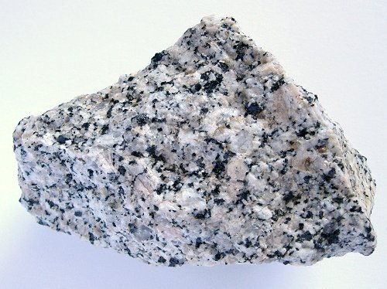
How are rocks and minerals related?
Look at a rock carefully…those tiny grains of various colors that you see are…minerals!
Granite consists of quartz (gray), plagioclase feldspar (white) and alkali feldspar (beige) plus dark minerals like biotite and hornblende.
Notes:
Not all rocks look like this, it depends how they were formed. However, all rocks contain a mixture of minerals.

Slide 8
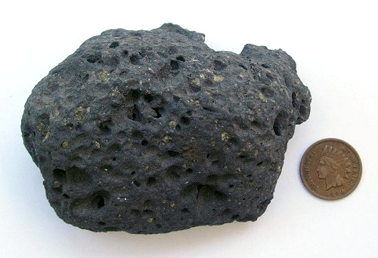
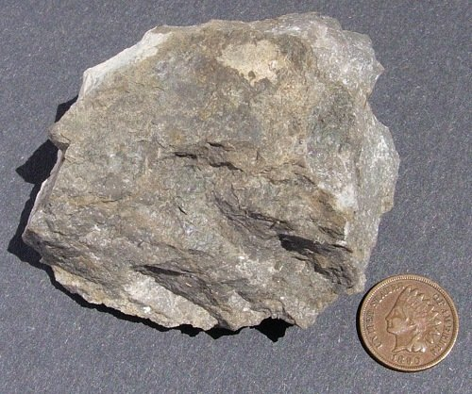
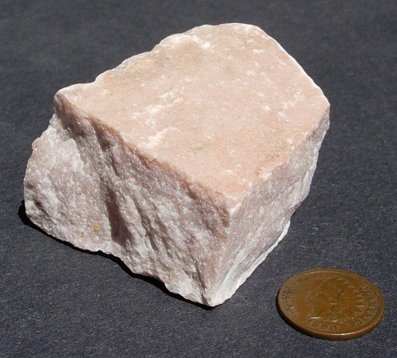
What is a rock?
Rocks are mixtures of minerals.
Basalt
Limestone
Marble
Notes:
This is a good time to review the definition of a mixture (a combination of two or more substances that do not form a new substance).
Sedimentary rocks often contain other materials, in addition to minerals. These materials might include shells, bones, and other organic sediments.

Slide 9
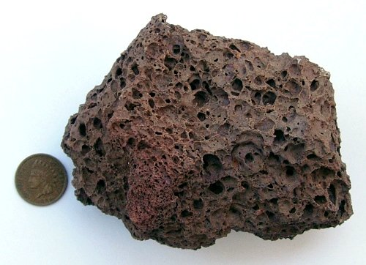
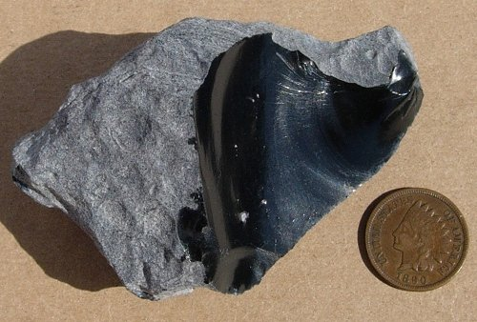

Rocks are classified according to how they were formed.
Igneous rocks form when magma (melted rock) cools and hardens. Magma that flows onto Earth’s surface is called lava.
Obsidian
Scoria
Notes:
Igneous rocks that cool slowly beneath the surface will be characterized by large crystals (intrusive igneous).
Igneous rocks that cool quickly on the surface will be characterized by lack of crystallization (extrusive igneous).

Slide 10
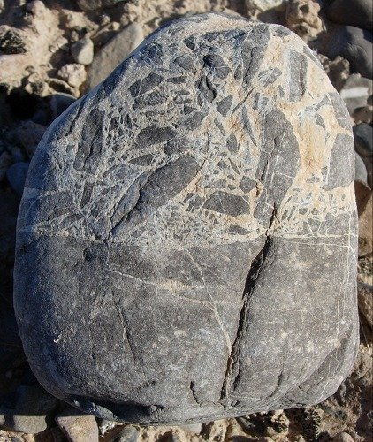
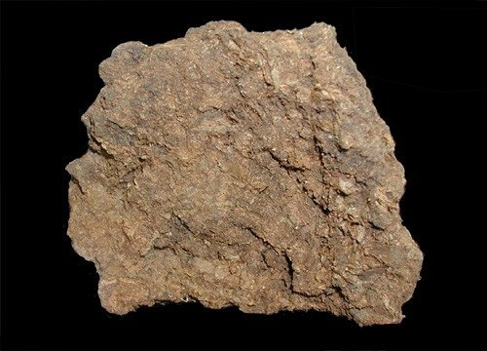
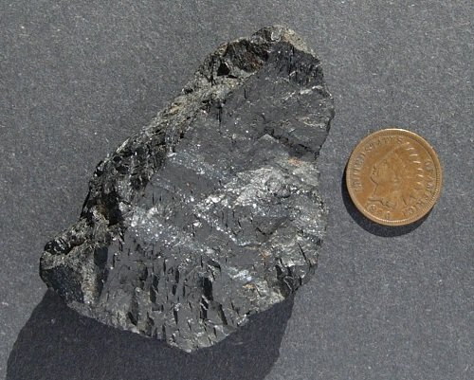
Sedimentary rocks form when sediments (bits of rock, shells, and remains of living things) are pressed and cemented together over millions of years.
peat
coal
Breccia
Notes:
These rocks may feel sandy, like sandstone. Pieces of organic material, like shells, may be visible, as in limestone. They may contain fossils. They are often easy to break apart.

Slide 11
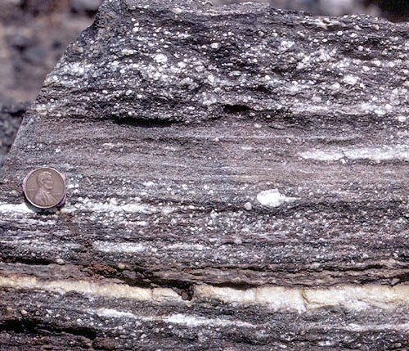
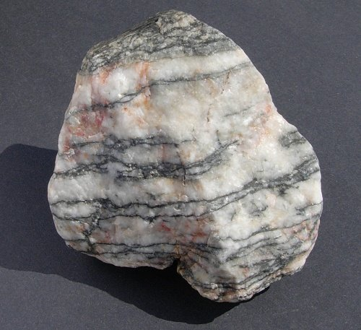
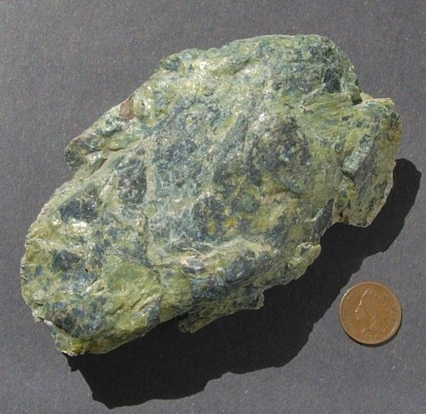
Metamorphic rocks form when rocks have been squeezed and heated deep inside Earth’s crust.
Mylonite
Gneiss
Serpentinite
Notes:
Metamorphic rock often have bands of minerals, called foliation, formed when the mineral layers were under great pressure.
Metamorphic rock that does not have bands is non-foliated.

Slide 12
Summarizing
Count off by 3’s
Each get a small piece of paper
    #1 Write igneous
    #2 Write sedimentary
    #3 Write metamorphic
Mix and mingle-when the teacher calls “time” turn to the person closest to you. Show them your paper and ask them to tell you how that rock type is formed. Repeat with other partner.
Mix and mingle 3 more times.
Notes:
Review the formation of each rock type before the students Mix and Mingle so that students know how the rock type on their sticky note was formed.
Music can be used to indicate when students should mingle (music playing) and when they should stop and share (music stops)

Slide 13
Guided Practice:
Talk to your shoulder partner about the answer to each question. Check your work.
Daunte performs several tests on a mineral to help identify it. The picture below shows one of the tests he performed. Which property of the mineral will Daunte be able to identify using this test?
  attraction to magnets
  streak color
  hardness
  cleavage

Slide 14
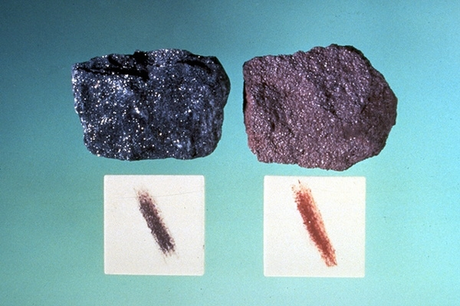
B
The answer is
Streak is the color of the mark that a mineral makes when it is scraped on a white tile. A mineral always makes the same color mark.
Notes:
Explain the rationale for the answer so that the teacher understands background knowledge

Slide 15
Lin found an igneous rock with grains of mineral crystal so small that they could not be identified . Where did this rock most likely form?
in a glacier
in the crust, just below the Earth’s surface
on the bottom of a river
on the surface of the Earth

Slide 16
D
The answer is
Igneous rock starts deep beneath the surface of the Earth where temperatures are high enough to melt rock. Sometimes that magma flows out of the ground onto Earth’s surface as lava and cools quickly there, forming igneous rock.
Notes:
If the minerals could not be identified then the rock must have been melted and then cooled very quickly so the minerals did not have time to crystallize. The rock must have formed from cooled lava and therefore formed on the surface of the earth as a result of a volcanic eruption.

Slide 17
Susan tested the properties of an unknown mineral that she found in a parking lot outside a store. Because of what she learned from her tests she turned the mineral back in to the store owner and was rewarded for returning a lost diamond. Which property helped Susan know that this mineral was a diamond?
  luster
  color
  hardness
  cleavage
Notes:
Explain the rationale for the answer so that the teacher understands background knowledge

Slide 18
C
The answer is
Although other minerals might have the same color, luster, or cleavage, a diamond is the hardest mineral. During testing Susan would have discovered that nothing she tried could scratch her mystery mineral.
Notes:
Harder materials scratch softer ones. Therefore, since a diamond is the hardest mineral, nothing can scratch a diamond.

Slide 19
Summarizing
Sort these words into 2 categories:
rock or mineral
crystal
luster
hardness
igneous
metamorphic
sedimentary
limestone
quartz
cleavage
streak
Notes:
Rocks: igneous, metamorphic, limestone, sedimentary
Minerals: luster, hardness, crystal, quartz, streak, cleavage

Slide 20
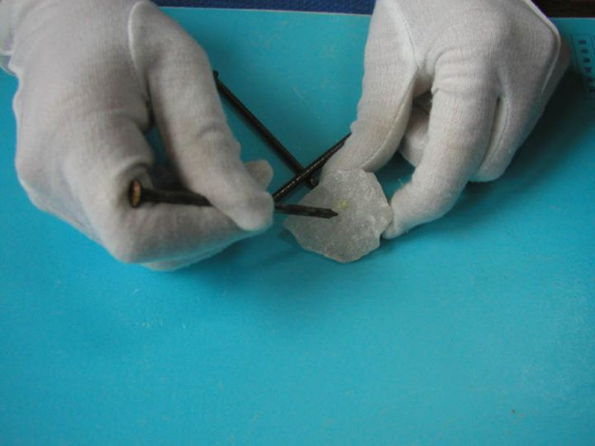
Check Your Understanding
1 Susanna performs several tests on a mineral to help identify it. The picture shows one of the tests she performed. Which property of the mineral will Susanna be able to identify using this test?
  luster
  streak color
  hardness
  cleavage

Slide 21
Check Your Understanding
2. Which of the following is the way that metamorphic rocks form?
  compressing and cementing
  deposition
  squeezing and heating
  weathering and erosion

Slide 22
Check Your Understanding
3. On a vacation to Hawaii, Lin picked up some pieces of black rock which was full of holes and felt very light. What type of rock had Lin most likely found?
  sedimentary
  metamorphic
  lava
  igneous

Slide 23
Check Your Understanding
4. Igneous rock is formed from magma. It takes extreme heat to turn rock to magma. Where would it be hot enough to melt rock?
    in the bottom of a stream
    in the Earth’s crust
    deep within the Earth
    0n the Earth’s surface

Slide 24
Check Your Answers
C-hardness is tested by scratching
C-metamorphic rock is formed by heating and squeezing (pressure)
D-igneous rock can form on the Earth’s surface from cooled lava
C-deep within the Earth is the only place that is hot enough to melt rock
Notes:
1. Hardness is tested by scratching the mineral sample with different materials of known hardness
2. Metamorphic rocks are formed from existing rocks which have been squeezed and heated deep inside Earth’s crust
3. Igneous rocks can form above ground from cooled lava, Hawaii is a series of volcanic islands
4. Only deep inside the Earth is it hot enough to melt rock (the lava that exits a volcano originated as magma which melted at the bottom of the Earth’s crust)

Slide 25
Summary Question
Describe how minerals can be identified by their properties.
Write a complete summary, include examples of properties that are used to identify minerals.
Notes:
Minerals are identified by their properties. No two minerals have the same properties. The properties that are used include luster, hardness, streak, color, and cleavage

